Slide 1
Symmetry Hierarchy of Man-Made Objects
Yanzhen Wang^{1,2}, Kai Xu^{1,2}, Jun Li², Hao Zhang¹, Ariel Shamir³, Ligang Liu⁴, Zhiquan Cheng², Yueshan Xiong²
¹Simon Fraser University
²National University of Defense Technology
³The Interdisciplinary Center, Herzliya
⁴Zhejiang University
Notes:
Good afternoon, everyone! I’m going to present our paper about symmetry hierarchy of man-made objects.

Slide 2
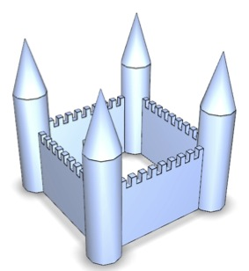
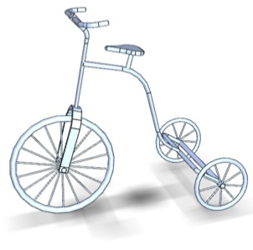
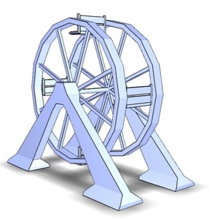
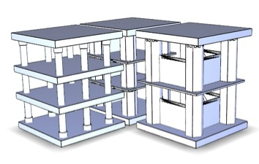
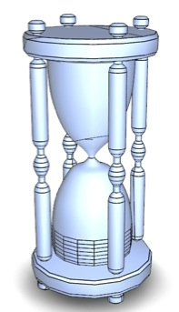
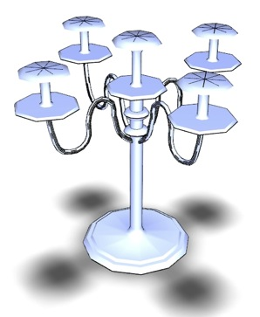
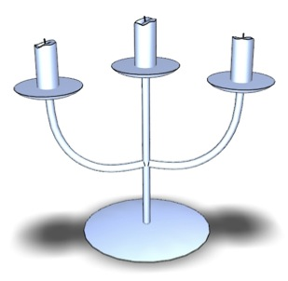
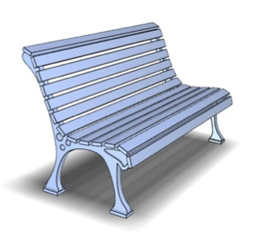
Symmetry in man-made objects
Notes:
We draw our motivations from the fact that symmetry is ubiquitous in the world, especially among man-made objects. In fact, repetition and regularity reflected by different forms of symmetries are often thought to be defining characteristics of man-made objects.

Slide 3
Symmetry hierarchy
Notes:
In our work, we propose a symmetry-induced, hierarchical organization of the model’s constituent parts. We call it the symmetry hierarchy. With its help, we can capture the structural information of the given model.

Slide 4
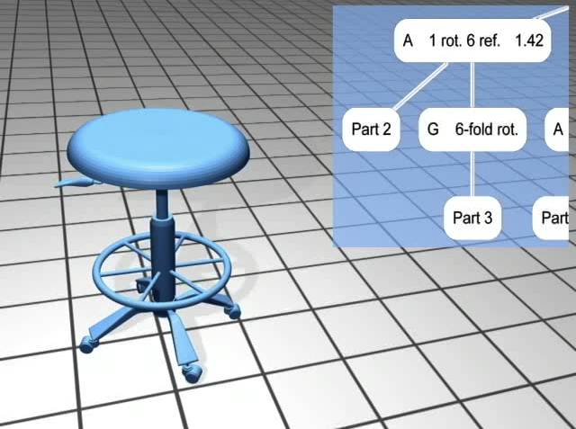
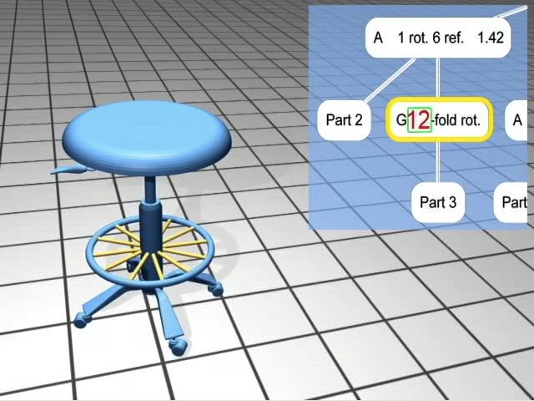
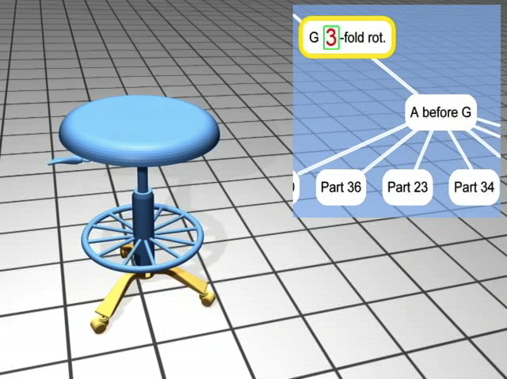
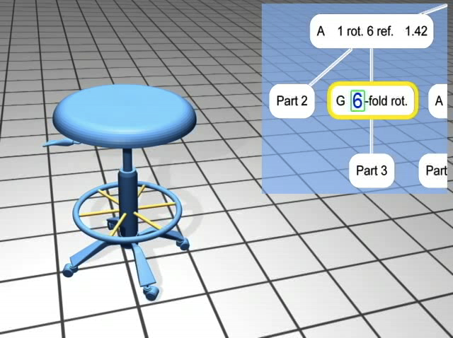
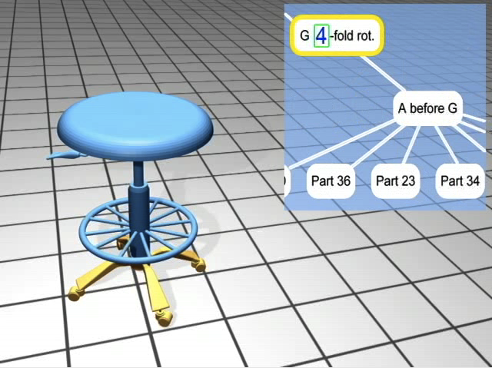
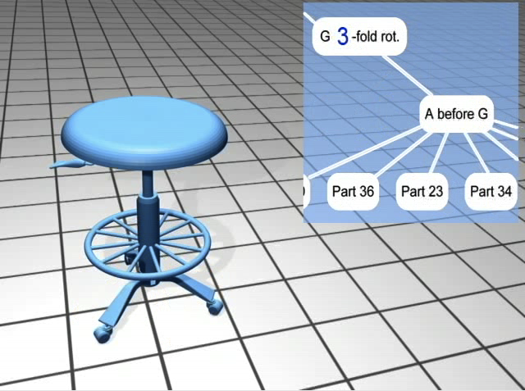
Structural shape editing
Notes:
It serves as a high-level shape representation and facilitates several high-level shape analysis and processing applications. One such example is structural shape editing. Take this stool as an example. Structural information about rotational symmetries is encoded using symmetry grouping nodes in the hierarchy. Then one can modify the parameters of these nodes to change the order of these rotational symmetries. Addition, deletion, and spatial rearrangement of the associated parts are automatically performed based on the new symmetry defined.

Slide 5
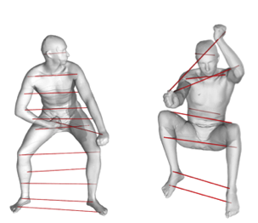
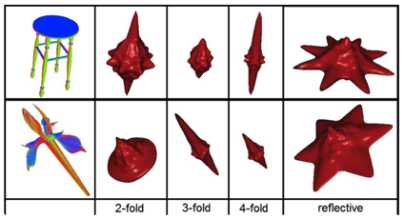
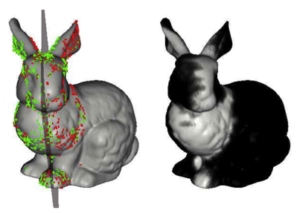
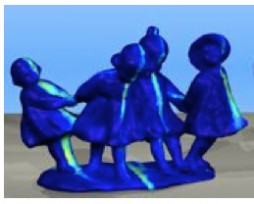
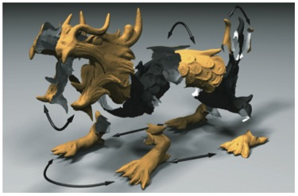
Symmetry/regularity detection
Global or isolated partial symmetries
Compound structural regularities
[Kazhdan et al. 2004]
[Ovsjanikov et al. 2008]
[Mitra et al. 2006]
[Podolak et al. 2006]
[Xu et al. 2009]
Notes:
Our work is naturally related to detection of symmetries or regularities. Most existing work extracts global or isolated partial symmetries.

Slide 6
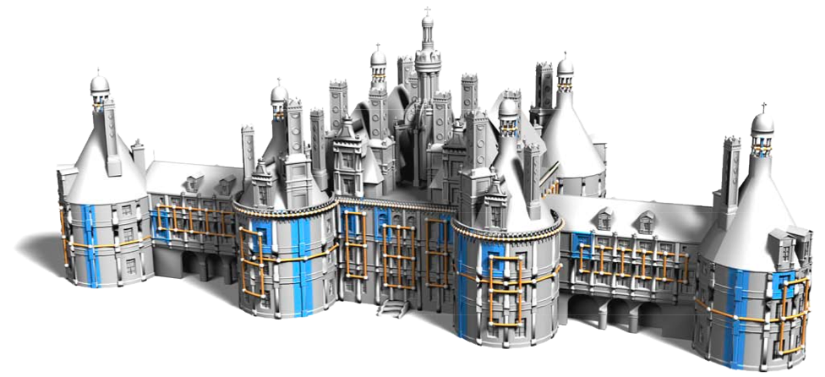
Symmetry/regularity detection
Global or isolated partial symmetries
Compound structural regularities
[Pauly et al. 2008]
Notes:
The nice work of Pauly et al. also detects compound structural regularities and derives a one- or two-parameter generative model. Their approach is structural, but only considers regular 2D grid structures, without performing a general hierarchical analysis.

Slide 7
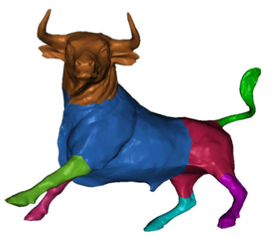
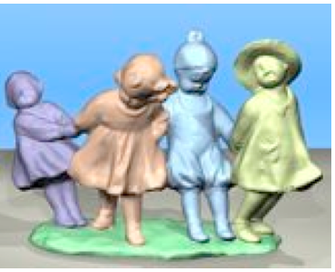
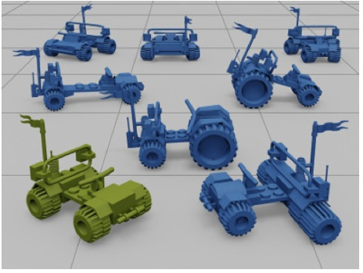
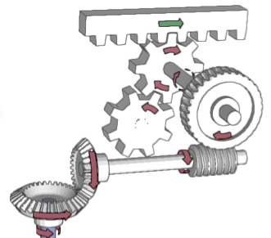
Symmetry-aware processing
[Podolak et al. 2006]
[Xu et al. 2009]
[Gal et al. 2009]
[Mitra et al. 2010]
Notes:
Using the detected symmetries and regularities, a number of shape processing tasks can be performed. Meaningful segmentations can be obtained by grouping mesh faces which form maximal-area region that possesses certain symmetries. Gal et al. introduce an intelligent shape editing paradigm called iWires. It works primarily with feature curves and incorporates a discrete set of symmetry-based constraints. Mitra et al. propose a nice approach to illustrating how things work. They also consider inter- and intra-part symmetries, but without organizing them in a hierarchical manner.

Slide 8
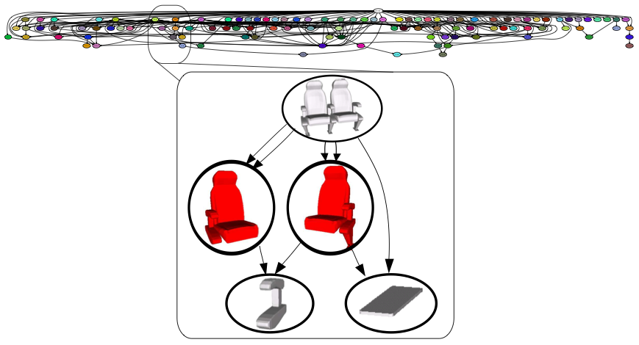
Symmetry-based hierarchical structures
Structuring 3D geometry [Martinet 2007]
Notes:
The thesis work of Martinet proposes a hierarchy construction method based on detected symmetries. The ideas are similar to ours. However, the goal there is to discover congruent scene components to “compress” symmetry-rich scenes, rather than shape understanding; there’s no rule about how components with different shapes are assembled in the hierarchy, nor perceptual consideration. Our goal is shape understanding and we apply symmetry analysis to both grouping of symmetric parts and assembly of connected parts.

Slide 9
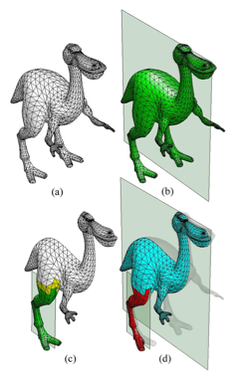
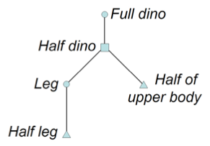
Symmetry-based hierarchical structures
Folding meshes [Simari et al. 2006]
Notes:
The folding mesh hierarchy proposed by Simari et al. is also relevant. It is produced in a top-down fashion by finding recursively the dominant symmetry in a connected sub-shape. However, no part structure information is considered and only reflectional symmetries are processed. Their method will probably leave a globally asymmetric model unprocessed. Our symmetry hierarchy deals with more general symmetries, even between disconnected parts, and it is built bottom-up, allowing for easy handling of largely asymmetric models. In one word, the folding mesh hierarchy is purely geometric while symmetry hierarchy is more structure-aware and goes towards a more functional analysis of shapes.

Slide 10
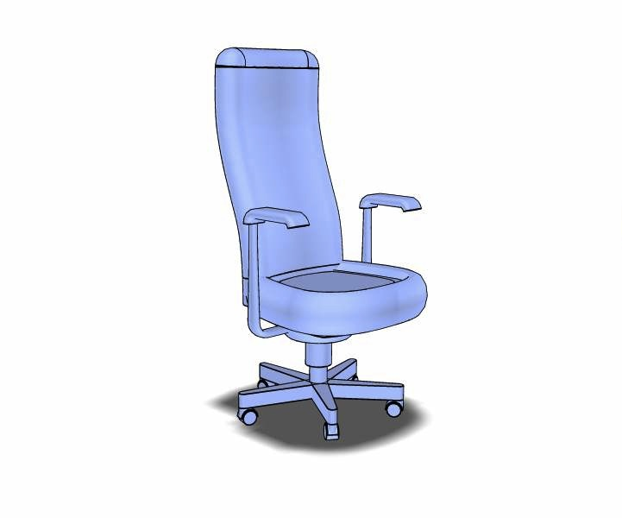
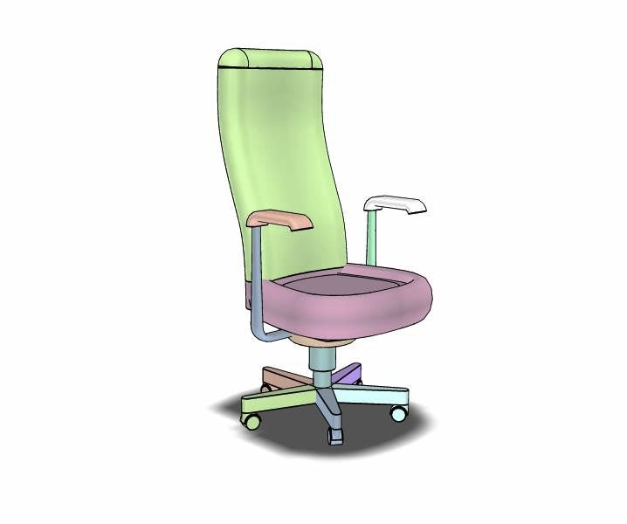
Symmetry hierarchy construction
Pre-segmentation
Notes:
Now, I’m going to talk about the construction of symmetry hierarchy. We assume that the input model is perfectly segmented into primitive parts.

Slide 11
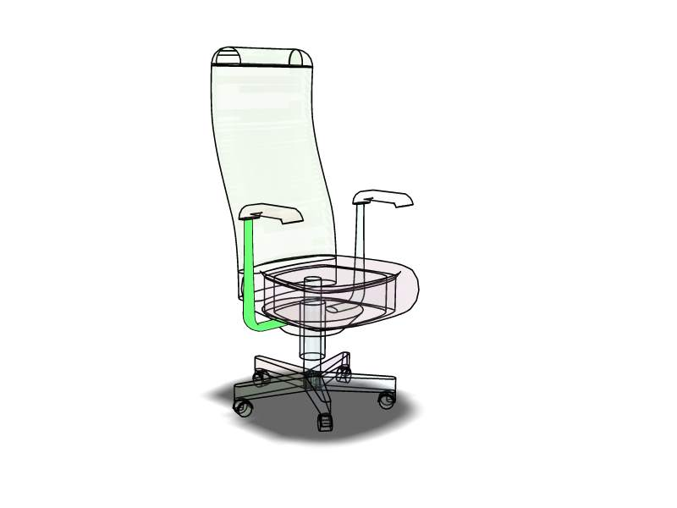
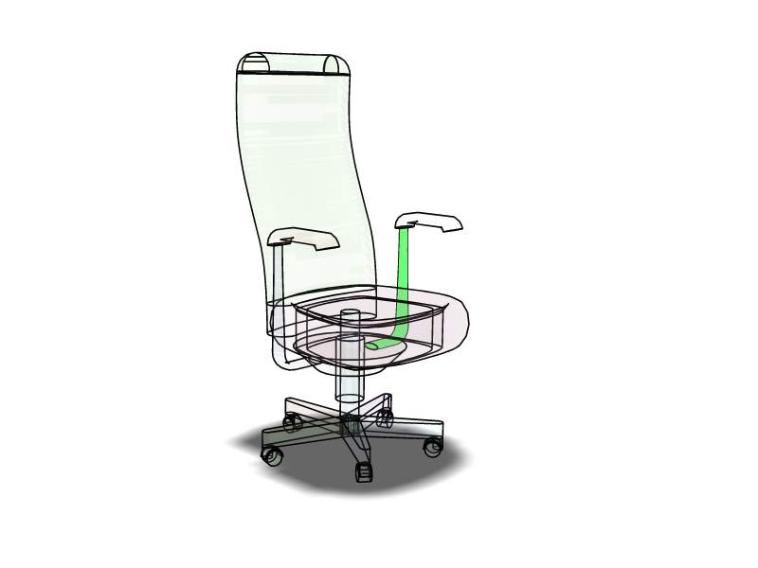
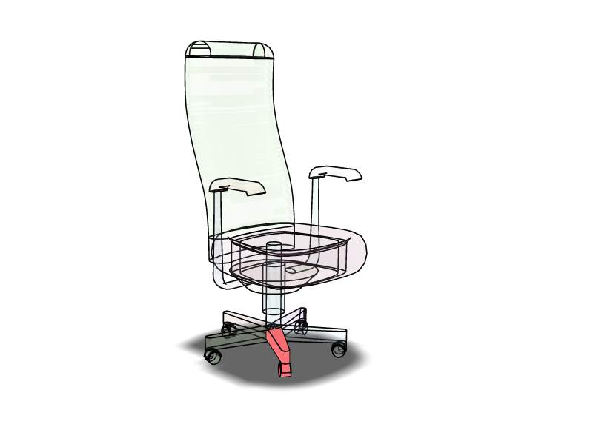
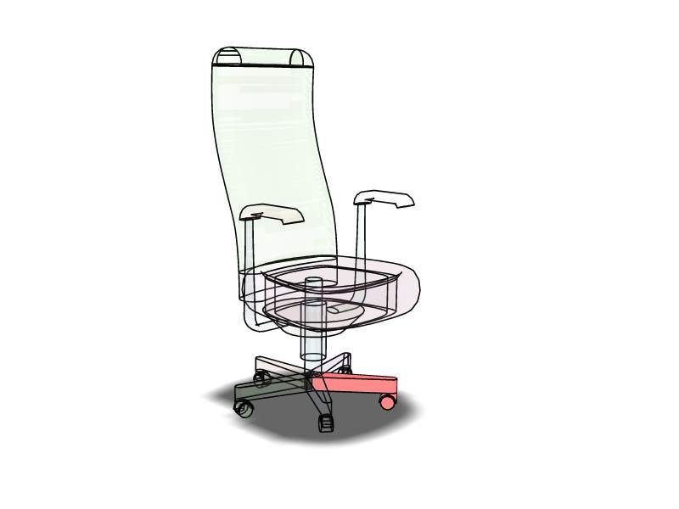
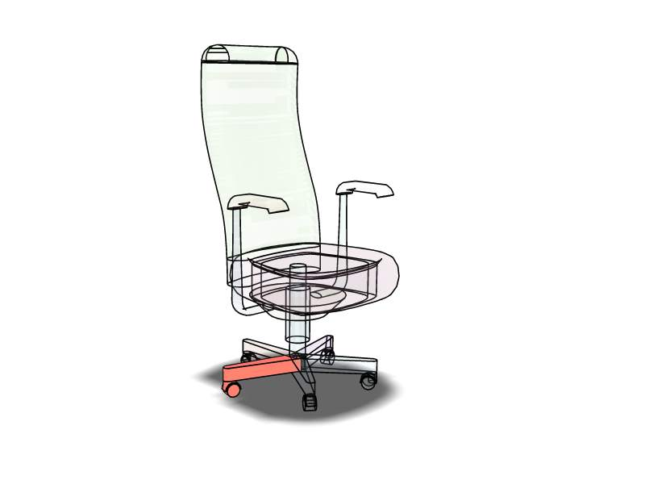
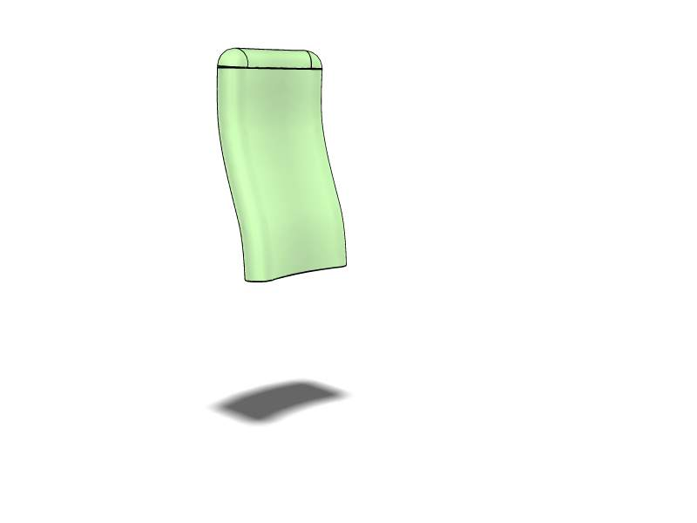
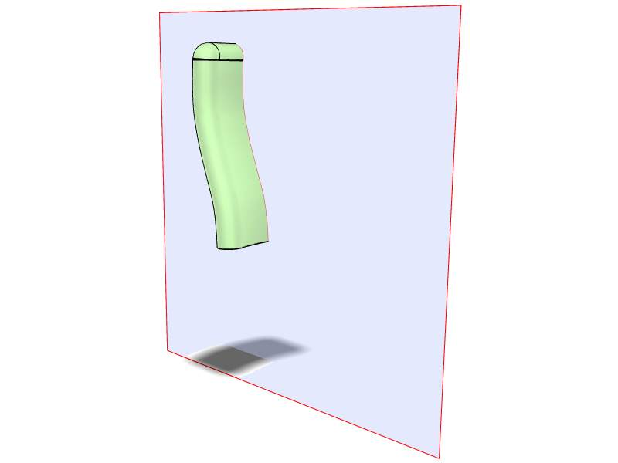
Symmetry hierarchy construction
Symmetry detection
Notes:
Then we detect both inter-part symmetry relationships such as the reflectional symmetry and the rotational symmetries shown on the slide, and self-symmetries possessed by individual parts.

Slide 12
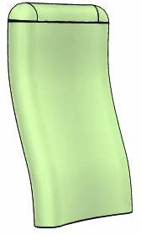
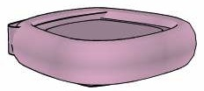
Symmetry hierarchy construction
Rotational symmetry
Reflectional symmetry
Connectivity
Initial graph
Notes:
We use these informations to build an initial graph for the input model. In the graph, each node corresponds to a part and edges encode the inter-part symmetries, as well as the connectivity relationships between parts. During the construction, the initial graph is iteratively contracted by using two types of operations.

Slide 13
Symmetry hierarchy construction
Grouping
Assembly
Graph contraction
Notes:
A grouping operation creates a new node grouping two or more existing nodes whose associated shapes are symmetric to each other.
Note that after each step of contraction, we also perform some necessary updates for the graph, such as modifying the connectivity edges.

Slide 14
Symmetry hierarchy construction
Grouping
Assembly
Graph contraction
Notes:
And an assembly operation creates a new node adjoining two nodes whose associated shapes are connected.
Typically there are multiple groups of parts that are symmetric to each other, and a node may be connected to multiple symmetry or connectivity edges…

Slide 15
How to order these operations?
Guiding principles
Perceptual grouping: Gestalt law of symmetry
Compactness of representation: Occam’s Razor
Precedence rules
Notes:
Then the question is how do we order all the possible graph contraction operations. Because our goal is to present a shape representation suited for high-level shape analysis, we prioritize contractions of nodes whose corresponding subparts are more tightly organized perceptually, functionally and whose organization leads to a more compact representation. For example, according to Gestalt law of symmetry for perceptual grouping, the brackets are likely not to be grouped by proximity, but will be grouped by the reflectional symmetries.
Taking these criteria into account, we came up with a set of precedence rules to order contraction operations. These rules are dominated by symmetry analysis.

Slide 16
Definitions
Equivalent symmetries
Rotational: same rotation axis
Translational: co-linear translation vectors
Reflectional: same reflection plane
Symmetry clique
A clique defined by equivalent symmetry edges
Grouping symmetry
Clique order
Notes:
In order to facilitate the following discussion, I’m going to introduce several definitions. We say two symmetries are equivalent if they are both rotational symmetries and share the same rotation axis, or they are both translational symmetries and their translation vectors are co-linear, or they are both reflectional symmetries and share the same reflection plane.
A symmetry clique is a subset of nodes in which every pair is connected by a symmetry edge describing an equivalent symmetry. That is to say, it’s a clique defined by equivalent symmetry edges. Such an equivalent symmetry is called the grouping symmetry of the symmetry clique and the number of nodes in it is called its order. For example, these trapezoids form a symmetry clique of order 6, with a rotational grouping symmetry.

Slide 17
Precedence rules
Grouping-assembly mixing rules
E.g., M1: grouping before assembly
A₁
A₂
B
Notes:
The first group of rules are grouping-assembly mixing rules. For example, according to rule M1, grouping by symmetry takes precedence over assembly operations. Let’s look at this 2D illustration. Instead of assembling A2 and B due to connectivity, we first group A1 and A2 by the reflectional symmetry. Grouping of nodes by contracting a symmetry clique follows Gestalt law of symmetry for perceptual grouping, and makes the representation compact. In fact, for a man-made object, parts that are symmetric to each other tend to perform the same function.

Slide 18
Precedence rules
Symmetry grouping rules
E.g., G1: Clique order
A₂
A₃
A₁
B
A₄
Notes:
The second group of rules are used to order groupings. Take rule G1 for instance. Higher-order symmetry cliques are grouped before lower-order ones. In this 2D illustration, instead of grouping A1 and B by the reflectional symmetry of an order 2, we first group A1~A4 by the rotational symmetry of an order 4. This rule follows the compactness principle, since contracting a higher-order clique removes more redundancy.

Slide 19
Precedence rules
Assembly rules
E.g., A1: symmetry preservation
B
A₁
A₂
Notes:
We also have rules for setting precedence of assembly operations. For example, we give precedence to assembly operations that preserve the most number of self-symmetries. In this 2D illustration, A1 and A2 share one common reflectional self-symmetry. A1 and B don’t share any self-symmetry. Therefore, A1 and A2 are assembled together first. The precedence rules are dominated by symmetry analysis. We also have a few other rules that deal with secondary geometric criteria. For the details, please refer to our paper.

Slide 20
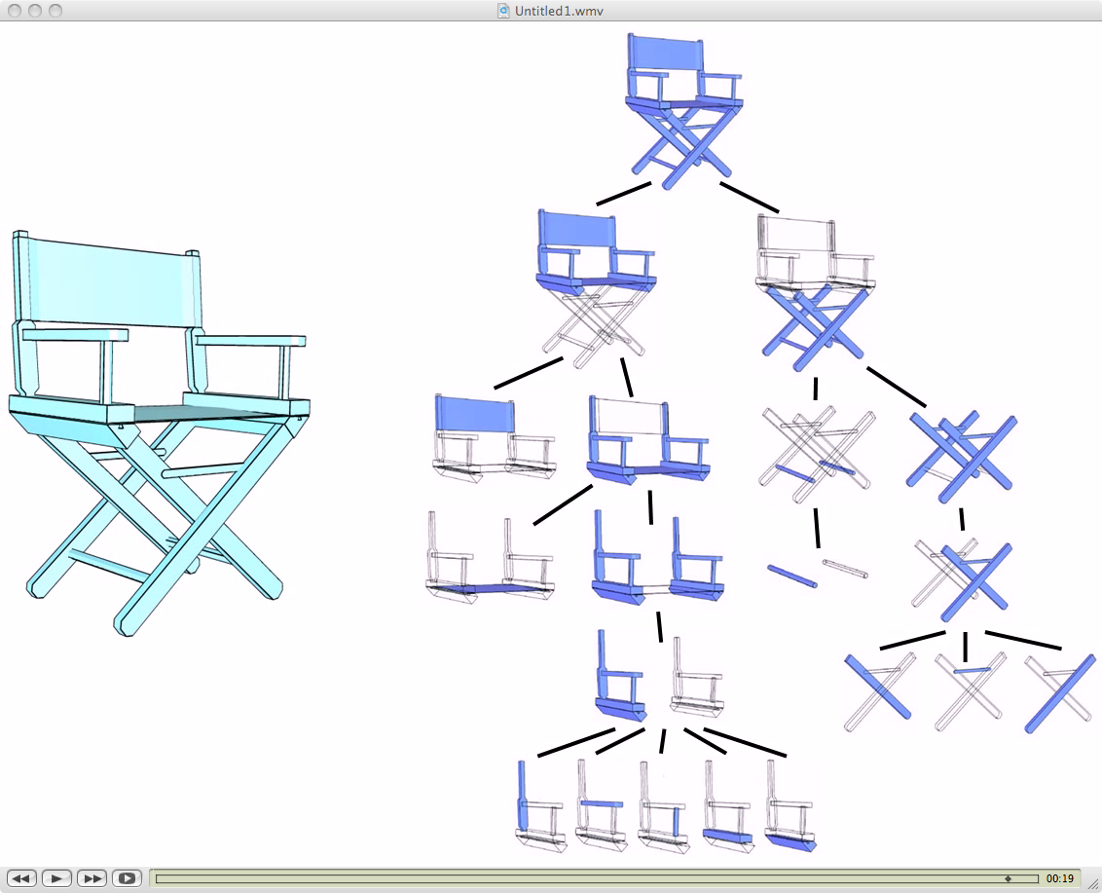
Symmetry hierarchy construction
Notes:
Now let’s look at a complete process of symmetry hierarchy construction. It utilizes the graph contraction approach based on the initial graph, guided by the precedence rules we proposed. Please note that symmetry hierarchy not only groups symmetric parts, but also assembles asymmetric parts that are connected, such as the node highlighted by the red square.

Slide 21
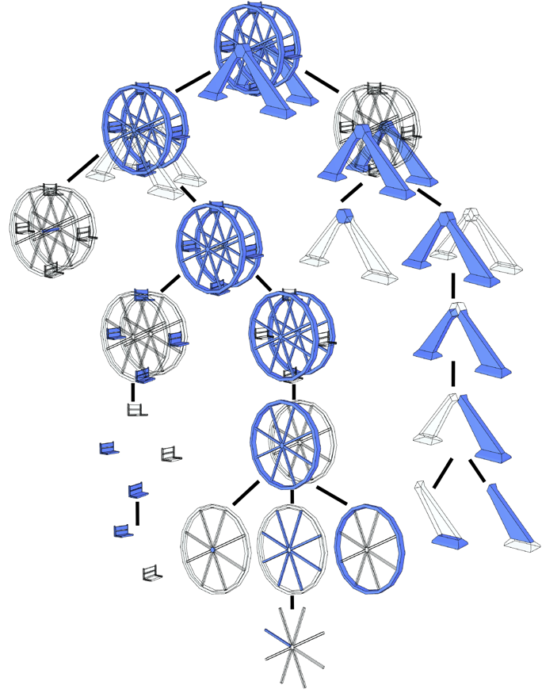
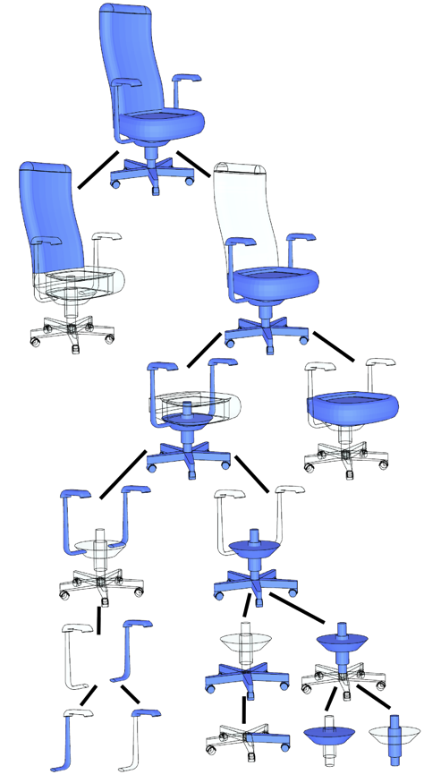
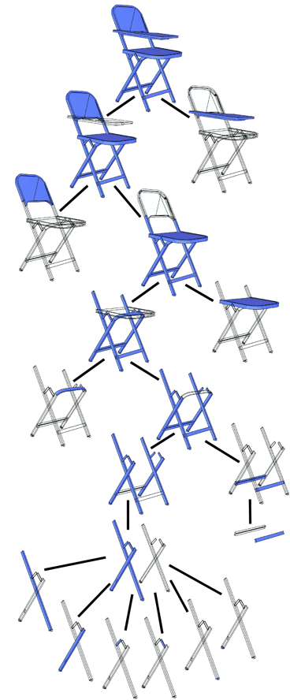
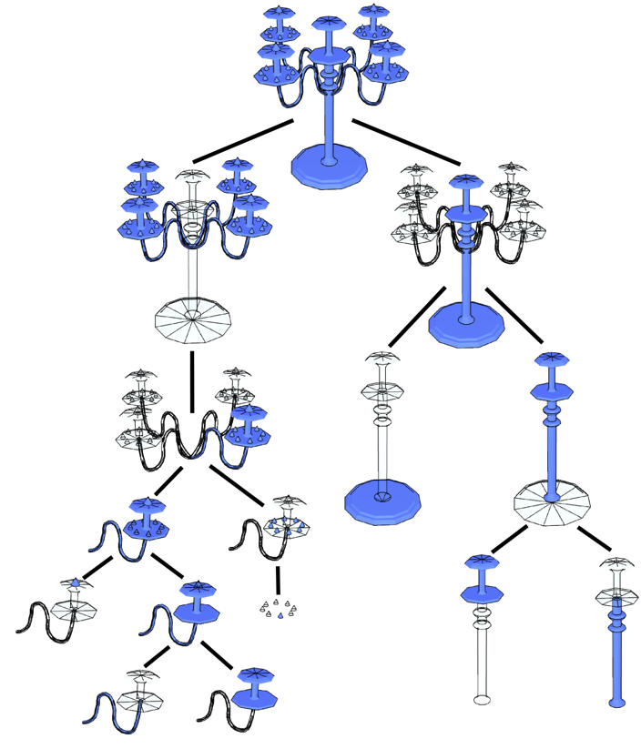
Symmetry hierarchies
Notes:
This slide shows several other resulting symmetry hierarchies for different shapes.

Slide 22
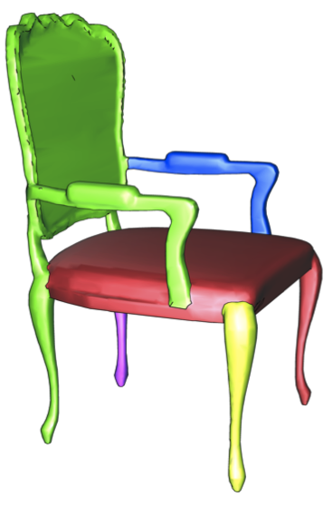
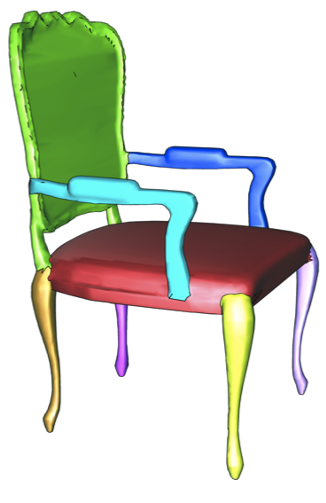
A missing part: pre-segmentation
Normalized cuts guided by shape concavity
[Golovinskiy and Funkhouser 2008]
Symmetry-driven enhancement
Notes:
In the above discussion, we intentionally skipped the pre-segmentation of the input model. In fact, many models in popular shape repositories are already composed of disconnected components that can be directly taken as the primitive parts. However, there are also other models defined by a single or a few large mesh pieces that need to be segmented. Many existing segmentation algorithms are possible. We employ a variant of the hierarchical clustering algorithm using normalized cuts guided by shape concavity. However, the concavity cues can sometimes be weak, especially for scanned models, so that the segmentation results can be imperfect.
To address this problem, we develop a symmetry-driven enhancement of the original segmentations. We examine the whole model and detect dominant global or partial reflectional symmetries. Then for each part of the original segmentation, we check whether it conforms to the symmetries detected. Whenever a part is symmetrically mapped to two or more different parts, it is split according to its symmetric counterparts to improve the symmetry of the segmentation.

Slide 23
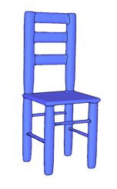
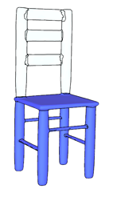
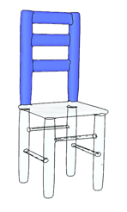
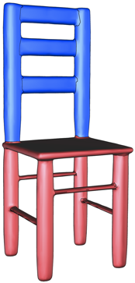
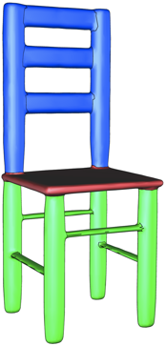
Applications
Hierarchical segmentation
Notes:
Now I’m going to talk about the applications. An immediate application of symmetry hierarchy is hierarchical segmentation, since reversing the contraction process of the initial graph naturally provides a unique series of embedded segmentations, each one more detailed than the previous.
The hierarchical segmentation tends to reveal the major function components at some level. For this example of a chair, they are back, seat and legs…

Slide 24
Applications
Hierarchical segmentation
Notes:
An important observation is that despite the rather large degrees of geometric and topological variations between the models within the same class, the symmetry hierarchy contains a semantic or most meaningful segmentation which existing hierarchical segmentation schemes would not be able to discover. Of course, we are not saying that such a consistent segmentation or the functionality information can be readily extracted from the symmetry hierarchy. It is one thing we leave for future work. Our point is that symmetry hierarchy provides an important hint and gives the means to achieve that.

Slide 25
Applications
Structural shape editing
Editing of man-made objects: semantics-aware
Two modes
Part structure → geometry (CAD/CAM design systems)
Geometry → part structure (iWires [Gal et al. 2009])
Symmetry hierarchy: suited for both
Structural view
Geometric view
Notes:
Another application we developed using symmetry hierarchy is shape editing for man-made shapes. Most works on shape editing and manipulation in graphics have focused on free-form deformation of natural objects. The deformation and editing of man-made objects present new challenges since the editing method must be aware of the shape semantics. Generally, there are two modes of editing operations. In CAD or CAM design systems, geometric objects are augmented with a set of parameters and constraints to define their semantics. Editing is possible by changing the parameters that affect the part geometry. The recent iWires tool of Gal et al. uses constraint satisfaction to propagate an editing change in geometry to the whole shape.
As a structural representation for man-made shapes, the symmetry hierarchy is naturally suited for both modes of editing.

Slide 26
Applications
Structural shape editing
Notes:
Using the structural view, the user can modify the parameters of an existing symmetry, such as its clique order, by selecting its associated symmetry grouping node from the hierarchy. Addition, deletion, and spatial rearrangement of the part are automatically performed based on the new symmetry defined.

Slide 27
Applications
Structural shape editing
Notes:
Using the geometric view, the user can transform, add, or delete parts by direct manipulation. Such actions may break existing symmetries. Using the symmetry hierarchy this can be automatically detected at the altered node to trigger proper action. By default, broken symmetries are restored at the lowest possible level.
Using the structural view the user can optionally select other nodes higher up in the hierarchy, that is to say, at a larger scale for symmetry restoration.

Slide 28
Conclusion
Contribution:
Symmetry hierarchy and its construction
A preliminary step towards high-level analysis of man-made shapes
An intermediate representation between low-level representation and functional shape analysis
Notes:
Now I’m going to conclude the paper. Our main contribution is proposing symmetry hierarchy of man-made objects and its construction approach. It can be seen as a preliminary step towards high-level analysis of man-made shapes. Symmetry hierarchy serves as an intermediate representation that bridges the gap between low-level geometry representation and high-level functional shape analysis.

Slide 29
Limitations
Not suitable for all shapes
Only exact extrinsic symmetries
Dependent on the initial segmentation
Greedy graph contraction scheme
Notes:
However, our symmetry hierarchy also has several limitations. Obviously, the associated analyses may not be suitable for all shapes, particularly those lacking sufficiently rich symmetry structures. Moreover, in our current work we only deal with exact extrinsic symmetries of three types.
The meaningfulness of the symmetry hierarchy also dependent on the initial segmentation. Our symmetry-based enhancement can turn imperfect segmentations into more meaningful ones in many cases. However, it is also limited by its dependence on symmetry analysis. For example, even after enhancement, it is unable to correctly separate part of the legs and part of the back of this chair, due to the fact that they form an integral part and breaking them apart doesn’t create more symmetries. It will in turn result in an imperfect hierarchy, which can be reflected by the imperfect hierarchical segmentation shown on the slide.
Finally, our graph contraction scheme is greedy and its local decisions may not always lead to a globally most meaningful symmetry hierarchy, though a precise definition of what the most meaningful hierarchy remains elusive and the answer is related to human cognition.

Slide 30
Future work
A rigorous objective function
User study
Other applications
e.g., Upright orientation [Fu et al. 2008]
Consistent symmetry hierarchy
Notes:
There are also a few other directions worth pursuing. First, our current set of precedence rules are the result of a thought process that takes into consideration various criteria. A rigorous objective function is likely difficult as it involves proper modeling of a cognitive process but should be attempt.
And if we are trying to precisely evaluate the perceptual meaningfulness of the symmetry hierarchy, we should best carry out a user study.
We believe that there will be many other applications in which symmetry hierarchy can make a difference. The emphasis on structure analysis and hierarchical organization allows us to even upright shapes a supervised learning algorithm may not handle. Actually, we are investigating this and other applications now.
Finally, a problem of great interest and utility is consistent symmetry hierarchy across a set of objects in the same class. The result would be a consistent hierarchical segmentation across the whole set.

Slide 31
Acknowledgement
Anonymous reviewers
Code and model help: Oliver van Kaick, Kun Liu
Fruitful discussions: Daniel Cohen-Or
Fundings: NSERC (Canada), the Israel Ministry of Science and Education, the Israel Science Foundation, NSF China, the Research Fund for the Doctoral Program of Higher Education (China), and the China Scholarship Council
Mesh models: the Princeton Shape Benchmark, SHREC’09, and Ran Gal

Slide 32
Thank you!
Project page: http://www.computer-graphics.cn/~eric/symh.html

